Slide 1


π
The Generative AI Revolution: A Month-Long AI Exploration
Impact of Generative AI
Business and Society
π
Week 1 Day 2: 4th Feb 2024

Slide 2
π
Agenda
Impact of GenAI across different Industry
Task performed by GenAI and Impact
Concern about AI
Responsible AI
Opportunity created by AI

Slide 3
π
“AI is impacting various industries by automating the entire job or part of job.”

Slide 4
π
Impact of GenAI across Industry
01
Technology [$240 - 460B]
Software development and testing
Cybersecurity
Web Development and design etc.
02
Retail [$240 - 390B]
Customer experience and service
Marketing and sales
Supply chain and inventory management etc.
03
Banking [$200 - 340B]
Customer service [Chabot and virtual assistant]
Risk management and compliance
Credit score and lending
04
Healthcare
Diagnostic and imaging
Drug discovery and development
Patient care and monitoring
05
Education
Personalized learning
Curriculum development
Education administration
Source: McKinsey Report

Slide 5
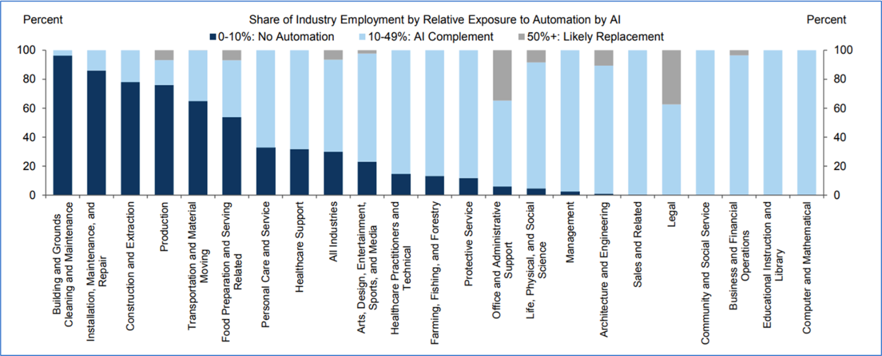
π
Impact of GenAI across Function
Source: Goldman Sachs Report

Slide 6
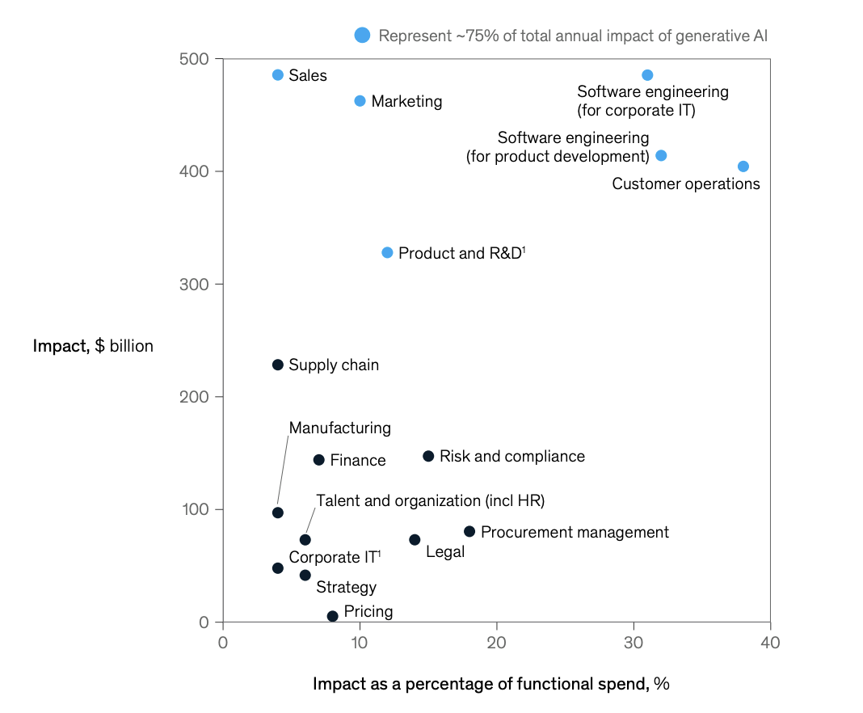
π
Impact of GenAI across Function
Source: McKinsey Report

Slide 7

π

Slide 8
π
Task Performed by Generative AI
Generation
Translation
Summarization
Search or Extraction
Classification or Tagging
Editing or Re-writing
Analysis or Interpretation

Slide 9
π
Task: Generation
Text Generation
Image Generation
Video Generation
Code Generation

Slide 10



π
Code Generation

Slide 11
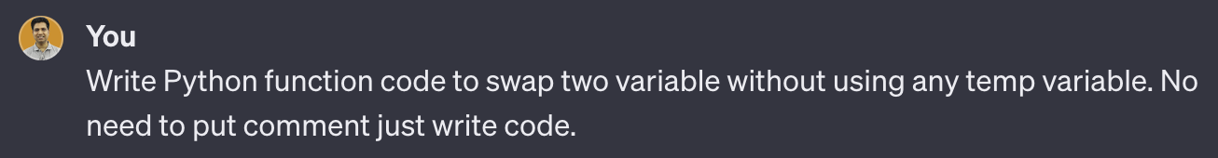
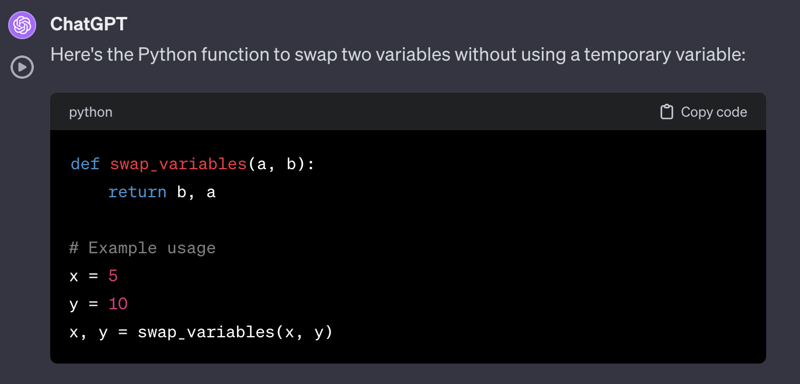
π
Code Generation: Example

Slide 12
π
Text Generation
Product description
Website write-up
Brand communication
Generate policy
Product document

Slide 13
π
Image Generation
Generate image for product portfolio
Marketing creative
Advertisement
Product design
E-commerce

Slide 14
π
Image Generation: LLM/Tool
DALLE-3
Midjourney
Adobe Firefly
Google Bard

Slide 15


π
Image Generation: Example

Slide 16


π
Image Generation: Example

Slide 17


π
Video Generation
Generate video for advertisement
Product education
Product training
Link: https://youtu.be/5WECsbqAQSk?si=Hy6d4hfz2Oq_1LzA

Slide 18
π

Slide 19


π
Task: Translation
Translate a piece of content from one language to another language. This could be text or audio.

Slide 20
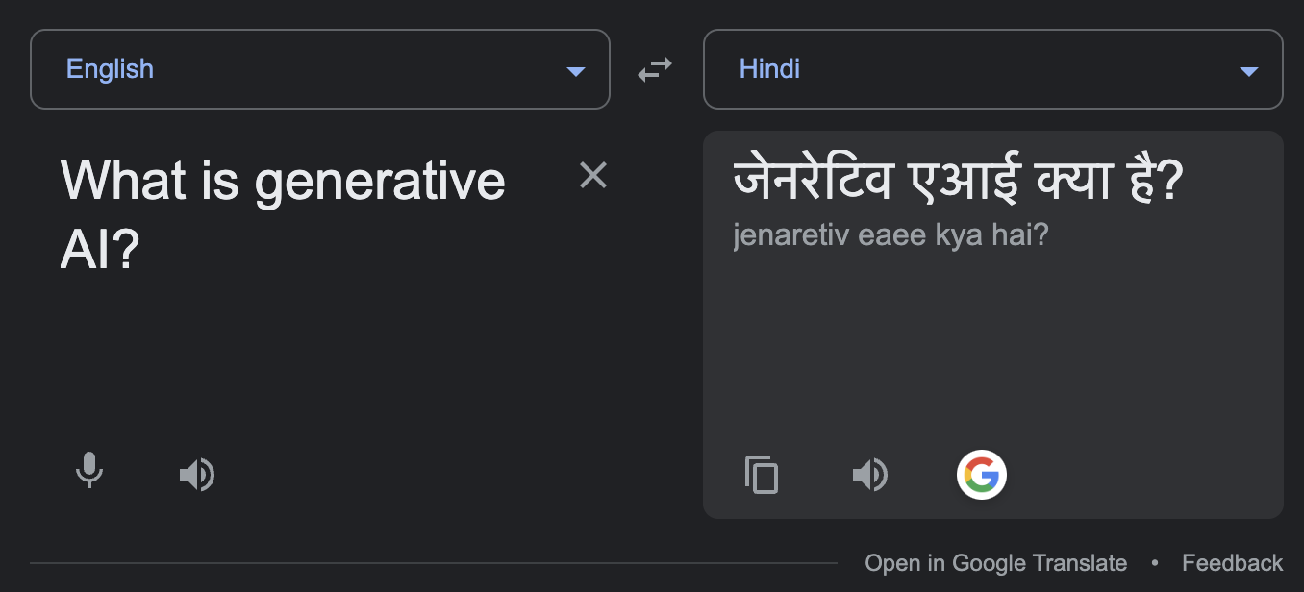
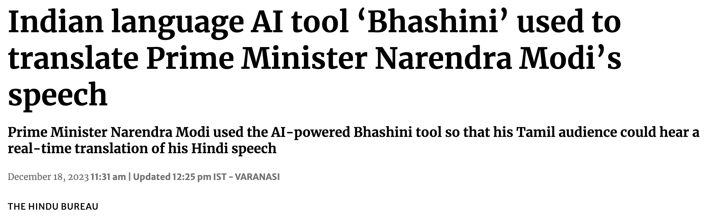
π
Translation: Example

Slide 21
π
Task: Summarization
Summarize large piece of text or document into smaller piece by retaining the key point:
Summarize email, documents and meeting notes
Summarize complex legal, policy and regulation documents
Summarize feedbacks, description and report

Slide 22
π
Task: Search or Extraction
Search for or extract relevant text, numbers or data from a large corpus of text:
Extract customer journey and life-cycle for product
Extract relevant information from knowledge base
Extract relevant piece of information from large document

Slide 23
π
Task: Classification or Tagging
Classify, tag of cluster text or documents as per your defined categories:
Classify review
Classify news and blog
Classify product

Slide 24
π
Task: Editing or Rewriting
Edit or re-write existing piece of text in such a way that suit your requirements:
Edit text to correct the grammar
Re-write to change the style and tone
Edit or re-write campaign for personalize touch in marketing

Slide 25
π
Task: Analysis or Interpretation
Analyse or interpret a large piece of text to get the relevant insight:
Analyse customer call and feedback to find customer issue
Analyse and interpret financial data
Analyse code for root cause and automation

Slide 26
π

Slide 27
π
Concern about AI
Amplifying humanity's worst impulses
Job loss like radiologist
Human extinction

Slide 28
π
Dimensions of Responsible AI
Fairness: Ensure AI does not amplify biases
Transparency: AI decisions should be understandable
Privacy: Protect user data and ensure confidentiality
Security: Safeguard AI systems from malicious attacks
Ethical Use: Ensuring AI is used for beneficial purpose

Slide 29
π
Opportunity Create by AI
Prompt Engineering
Generative AI Developer
AI-assisted Designer
Digital Artist
Content Creator using AI

Slide 30

π
Thank You!
Mokarbeen Ansari​
www.linkedin.com/in/mokarbeenansari/​

Slide 31

sd
The Generative AI Revolution: A Month-Long AI Exploration
Session-2
Week 1 Day 2: 4th Feb 2024

Slide 32

π
Prompt Engineering
What is prompting
Importance of prompting
Structure of a good prompt
Enhancing LLM capabilities using advanced prompting techniques
π

Slide 33
π
What is a prompt?
A prompt refers to the input provided to the model to generate a response. The prompt can be a question, instruction, or any form of input text that guides the model in producing relevant output.
What is prompt engineering?
Prompt engineering is the process of designing and optimizing prompts used in natural language processing (NLP) models, such as ChatGPT, chatbots, or virtual assistants. This involves crafting prompts that are clear, concise, and effective in eliciting the desired response.

Slide 34
π
What is prompt priming?
“Priming” refers to the practice of providing some initial input to the model before generating a response. The
initial input is intended to guide the model toward generating a response that is more relevant and coherent with
the user's intended output.
Example:
Without priming: Where should I go on my next vacation?
With priming: I’d like to go on a trip with my wife and kids. The location should be tropical, we’d love to be close to
the beach, I’d like the flight to be one direct flight to and from LAX, and I have a travel budget of $5,000. Where
should I go on my next vacation?
Priming Output: One suggestion for your tropical family vacation within a $5,000 budget could be Cancun,
Mexico. Direct flights from LAX are available, and you can find affordable all-inclusive packages with prices
starting at around $1,000 per person for a week-long stay. Popular family activities in Cancun include snorkelling,
visiting ancient ruins, and exploring local beaches and restaurants.

Slide 35
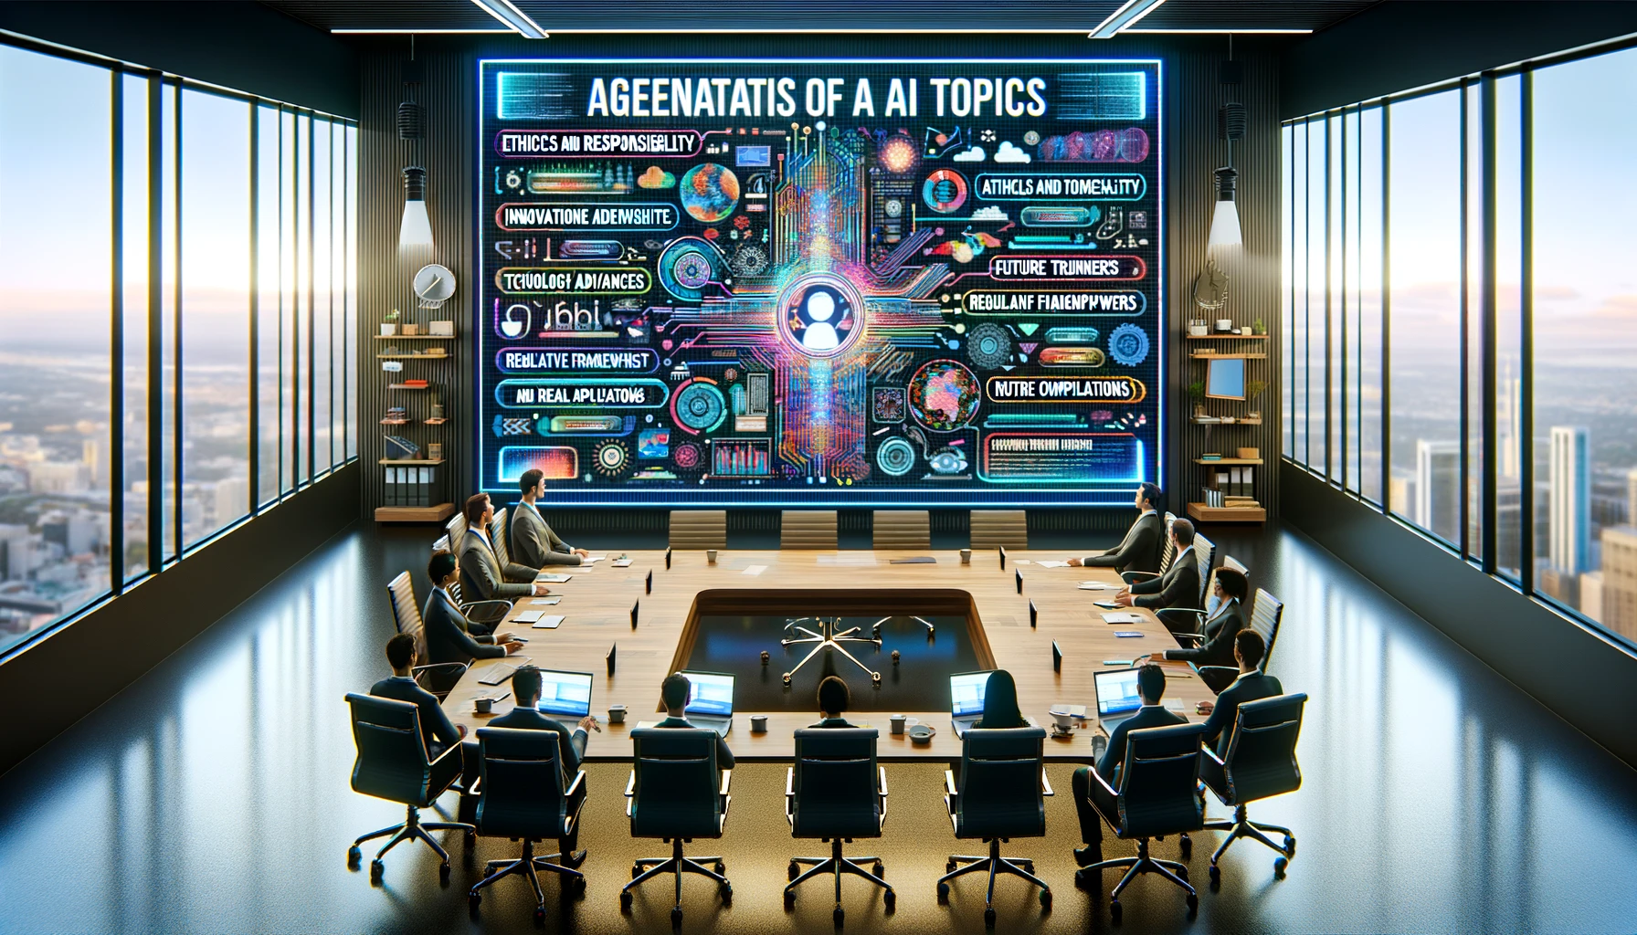
π
Engineering a Good Prompt
Prompting Principle – 1
(Providing Clear instructions)
Five components of a good prompt:
Explicitly state the task to be performed to get the required output
Role of the language model for performing the task
Context in which the task must be done
Guidelines on how to perform the task
The desired output format of the ideal response

Slide 36
π
Applying Prompt Engineering for Language Tasks
Task
The task is to write compelling ad copy for a new laptop model highlighting its features, benefits, and special offers or pricing on our e-commerce platform.
As a language model, I will serve as a copywriter who understands marketing strategies and consumer psychology. I will craft the ad copy to be engaging, informative, and persuasive, using language that resonates with a diverse audience of potential buyers.
The ad copy is intended for an online e-commerce website targeting consumers interested in high-configuration laptops. The Laptop features a Powerful Processor, Dedicated Graphics Card, High-Resolution Display, Large and Vibrant Screen, Long Battery Life, Fingerprint Sensors or Facial Recognition, Fast Storage and many more The context also includes a competitive market with tech-savvy customers who value innovation and quality.
The ad copy should:
####
Begin with an attention-grabbing headline.
Include key selling points like exceptional Performance, Premium Build and Design, and Future-Proofing.
Mention any discounts, warranties, or limited-time offers.
Have a call to action that encourages immediate purchase.
Be concise, with a friendly and inviting tone.
Avoid technical jargon that might confuse the average customer.
####
The ad copy should be formatted as follows:
####
A catchy headline
A brief introduction
A bullet list of key features and benefits
A closing sentence with a call to action
####
The ad copy should be no more than 200 words to ensure it is quick to read and easy to understand
Role
Context
Guidelines
Output Format

Slide 37
π
Output
Unleash the Future: Power and Elegance Combined!
🌟 Introducing the Ultimate High-Performance Laptop 🌟
In a world where technology is constantly evolving, step ahead with our new high-configuration laptop. Designed for those who demand excellence, it's more than just a laptop – it's a revolution in your hands.
Key Features and Benefits:
🚀 Exceptional Performance: Experience lightning-fast speeds with our cutting-edge processor and dedicated graphics card. Say goodbye to lag and hello to seamless multitasking.
💎 Premium Build & Design: Sleek, sturdy, and stylish. A design that speaks volumes about your taste for quality and elegance. Take it anywhere, turning heads as you go.
📺 Vibrant High-Resolution Display: Dive into a large, vibrant screen that brings visuals to life. Immerse yourself in stunning clarity and vivid colors for work and play.
⏳ Long Battery Life: Stay unplugged longer. Our extended battery life means more work, more play, and less worry about finding the nearest outlet.
🔐 Advanced Security: Keep your data safe with cutting-edge fingerprint sensors and facial recognition technology – security at your fingertips.
🚄 Fast Storage: Store more and access it faster. Enjoy ample space with rapid response times, keeping everything you need at your fingertips.
Special Offers:
💰 Exclusive Discount: Grab a 10% discount for a limited time only!
🛡️ Extended Warranty: Peace of mind with an additional 1-year warranty at no extra cost.
Ready to Elevate Your Experience?
🛒 Don't miss out! Order now and step into the future of computing. Your journey to excellence starts here!

Slide 38
π
Applying Prompt Engineering for Code-Related Tasks
Develop a script or application using Slack's API that will sync the company's website with the Slack users. If a user is added to Slack, he/she should be added automatically to the company's website. If the user is removed from Slack, he or she should be removed from the Company's website.
As a language model, my role is to act as a software developer who can outline the steps necessary to write this code, including explaining authentication with Slack's API, handling requests and responses etc.
The code will be used to automatically add or remove the users to the company's website when the IT team adds or removes a user from Slack, that user should be automatically added or removed from the company's website respectively.
The steps to perform this task would include:
####
Registering the application with Slack to obtain the necessary credentials (Client ID and Client Secret).
Using the credentials to authenticate
Setting up a webhook or using the Slack API's to update the website.
Writing a function to update the company's website
Handling errors and ensuring the message format is compatible with Slack's formatting options.
####
The ideal response should be a code snippet or a set of code snippets that are ready to be implemented, with comments explaining each section of the code.
Task
Role
Context
Guidelines
Output Format

Slide 39
π
Applying Prompt Engineering for Code-Related Tasks (ChatGPT output)
Creating a full-fledged application to synchronize a company's website user list with Slack's user list is a complex task that involves several components. Below, I will outline a basic Python script using Flask to handle the Slack Events API and update the user list on the company's website accordingly.
Step-by-step guide and code snippets:
Registering Your Application with Slack:
Go to your Slack workspace's app configuration page to create a new app.
Add permissions to access user data and subscribe to user change events.
Obtain the Client ID, Client Secret, and Signing Secret.
Setting Up OAuth for Slack Authentication:
Implement an OAuth flow to get the necessary access token to use Slack APIs.
Setting Up the Flask Application:
Create a Flask application to receive events from Slack.
Verify the requests from Slack using the Signing Secret.
Handling User Addition and Removal:
Listen for user addition and removal events.
Update the company’s website using its API.
Error Handling and Formatting:
Add error handling to manage unexpected issues.
Ensure the message format aligns with Slack’s requirements.

Slide 40
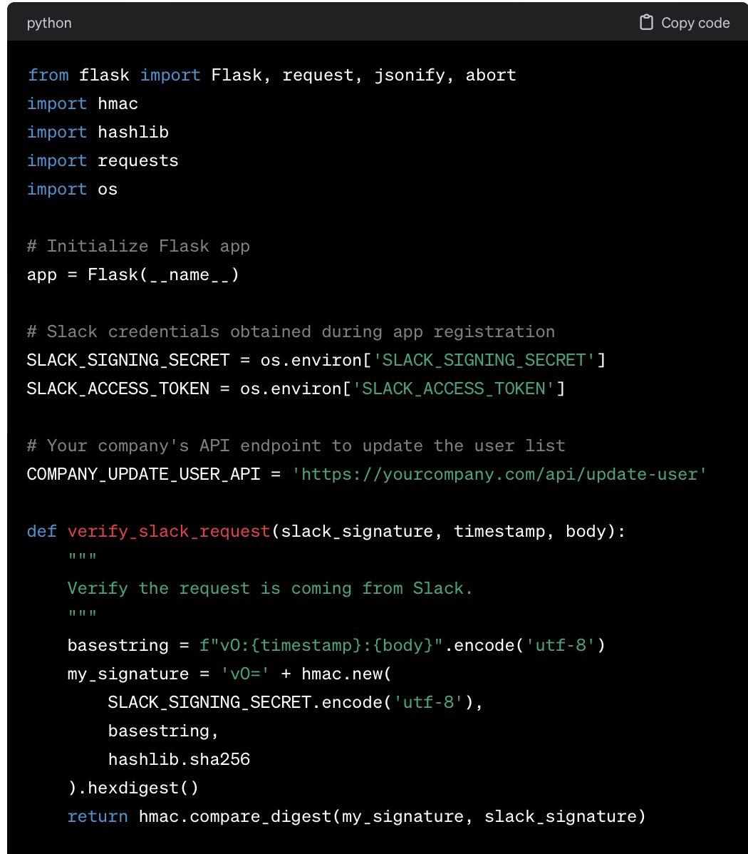
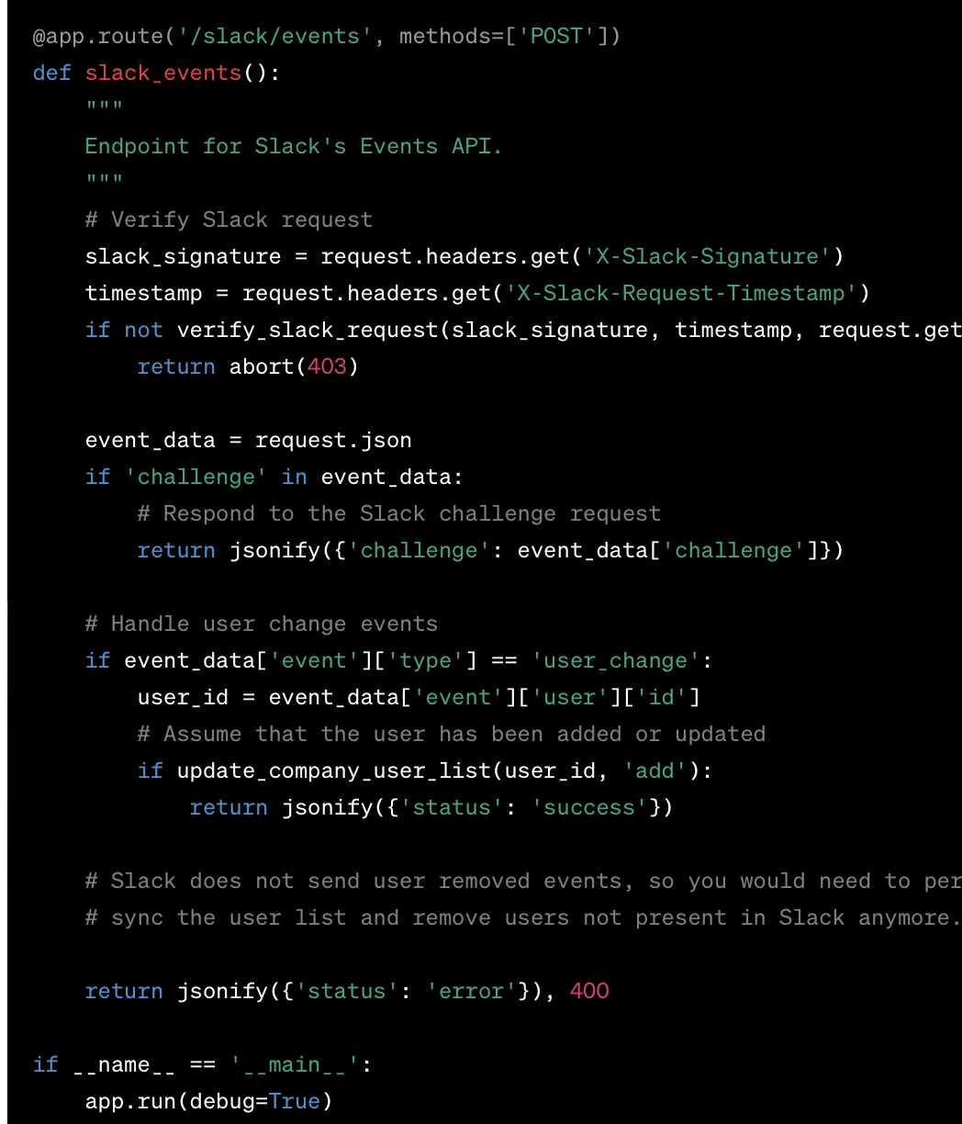
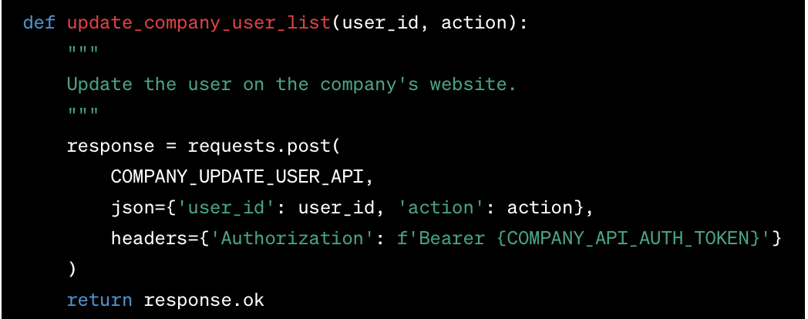
π
Applying Prompt Engineering for Code-Related Tasks (high-level code outline)

Slide 41
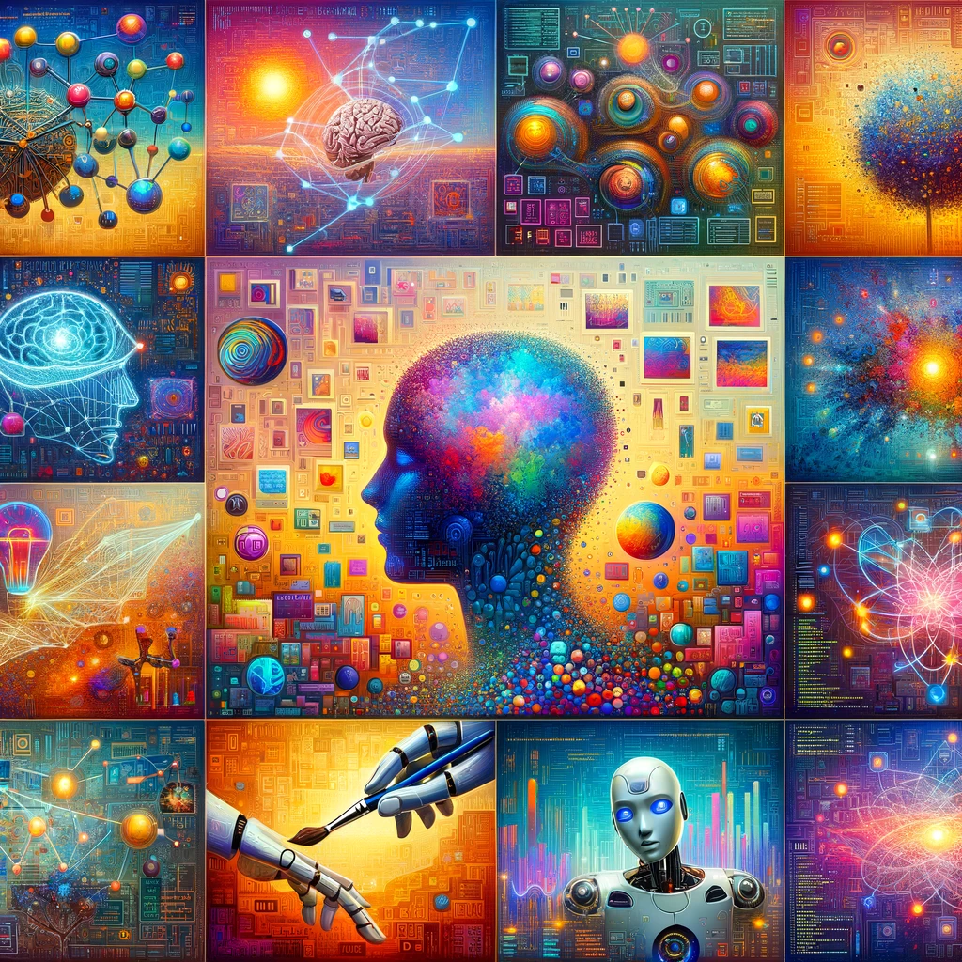
π
Engineering a Good Prompt
Prompting Principle – 2
(Enhancing LLM Reasoning Capabilities)
Chain-of-Thought prompting (asking to approach step by step)
Few-Shot prompting (provide relevant and exhaustive examples)

Slide 42

π
Chain-of-Thought prompting
Chain-of-thought prompting is a technique used in AI language models like GPT-3 and GPT-4 to improve performance on reasoning tasks. This approach involves prompting the model to generate intermediate steps or reasoning processes while solving a problem rather than directly aiming for the final answer.
Key Characteristics:
Explicit Reasoning: The prompt includes the problem and a step-by-step breakdown of how one might logically solve it.
Clarity and Detail: The reasoning steps are clear and detailed and follow a logical sequence.
Emulation of Human Problem-Solving: The model is guided to emulate how a human might approach the problem, considering various aspects and possibilities.

Slide 43
π
Chain-of-Thought prompting Examples
Mathematical Problem:
Standard Prompt: "What is 35% of 240?"
Chain-of-Thought Prompt: "To find 35% of 240, first calculate 10% of 240, which is 240 divided by 10. Then, multiply this by 3 to get 30%. After that, find 5% of 240 by halving the value of 10%. Finally, add these values together to get 35%."
Model's Response: "10% of 240 is 24. So, 30% is 24 x 3 = 72. 5% of 240, which is half of 10%, is 12. Therefore, 35% of 240 is 72 + 12 = 84."
Prompt: If there are 5 apples and you take away 3, how many do you have?
Chain-of-Thought:
You start with 5 apples.
The phrase 'take away 3' means you are taking 3 apples.
So, you now have 3 apples in your possession.
It’s not about how many apples are left in the original place but how many you have taken.
Therefore, you have 3 apples.

Slide 44

π
Few-Shot prompting with Examples
Few-shot prompting is an approach where an AI model is given a small number of examples (typically less than 10) to help it understand and perform a specific task. This method relies on the model's pre-trained knowledge and its ability to generalize from a few examples to new, unseen instances.
1. Sentiment Analysis:
Example 1: "Sentence: 'I love sunny days.' Sentiment: Positive"
Example 2: "Sentence: 'This movie is boring.' Sentiment: Negative"
New Input: "Sentence: 'The cake tastes amazing.' Sentiment: ?"
Expected Output: "Positive”
2. Translation:
Example 1: "English: 'Hello, how are you?' French: 'Bonjour, comment ça va?'"
Example 2: "English: 'Thank you very much.' French: 'Merci beaucoup.'"
New Input: "English: 'Where is the library?' French: ?"
Expected Output: "Où est la bibliothèque?"

Slide 45
π
Few-Shot prompting Examples
3. Mathematical Problems:
Example 1: "Problem: 'If I have 3 apples and eat one, how many are left?' Solution: '2 apples.'"
Example 2: "Problem: 'A shirt costs $20 and I have a $5 coupon. How much do I pay?' Solution: '$15.'"
New Input: "Problem: 'If I have 5 oranges and my friend gives me 2 more, how many oranges do I have?' Solution: ?"
Expected Output: "7 oranges"
4. Grammar Correction:
Example 1: "Incorrect: 'He don't know.' Correct: 'He doesn't know.'"
Example 2: "Incorrect: 'She go to school every day.' Correct: 'She goes to school every day.'"
New Input: "Incorrect: 'They has a cat.' Correct: ?"
Expected Output: "They have a cat."
AI model uses the provided inputs and outputs to learn the pattern or the relationship between them. When a new input is given without an output, the model applies the inferred pattern to generate an appropriate output.

Slide 46
π
Nuggets
Chrome extension: YouTube Summary with ChatGPT
https://github.com/f/awesome-chatgpt-prompts
Also Visit:
https://www.deeplearning.ai/short-courses/chatgpt-prompt-engineering-for-developers/
https://www.deeplearning.ai/short-courses/
π

Slide 47

π
Thank You!
Vinit Narula
www.linkedin.com/in/vinitnarula/

